Slide 1
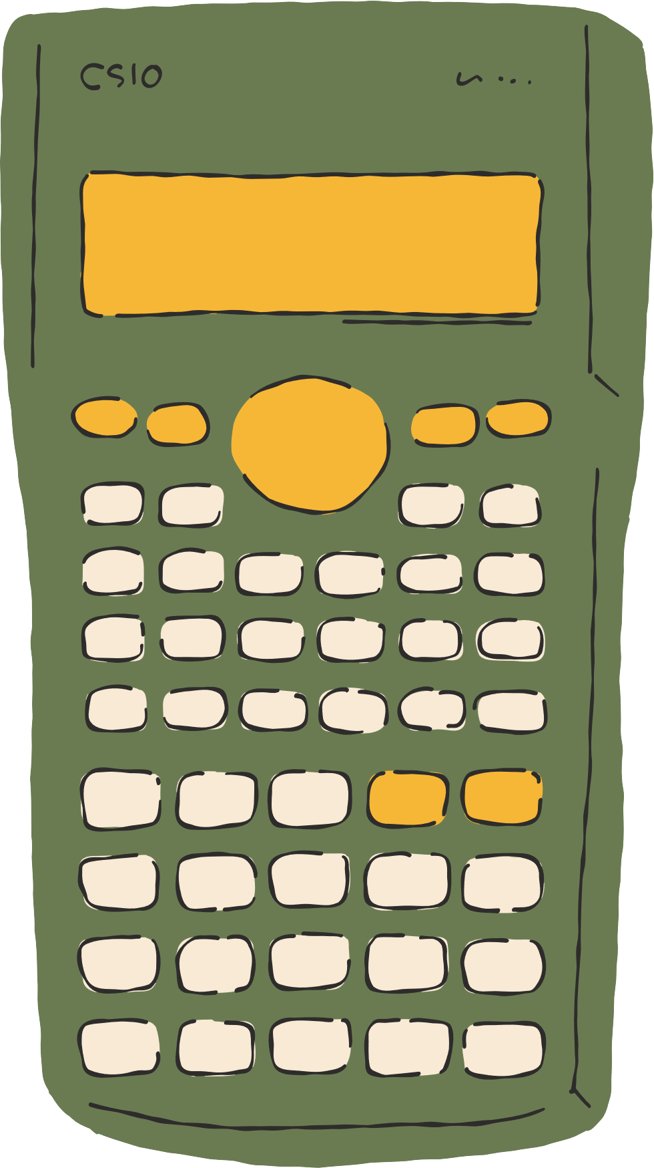
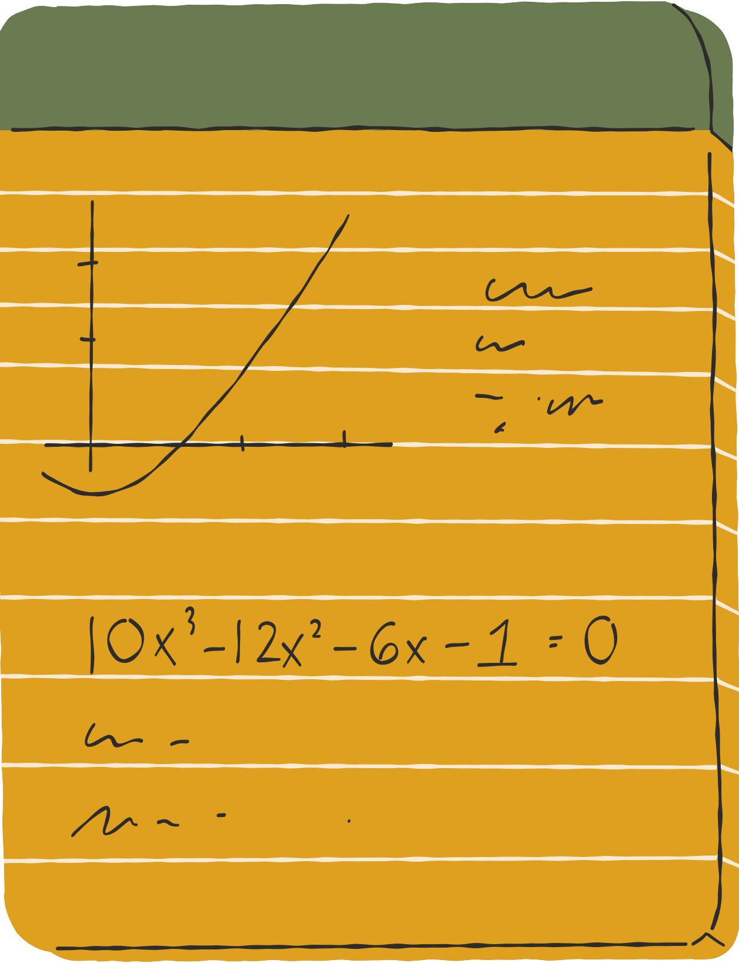







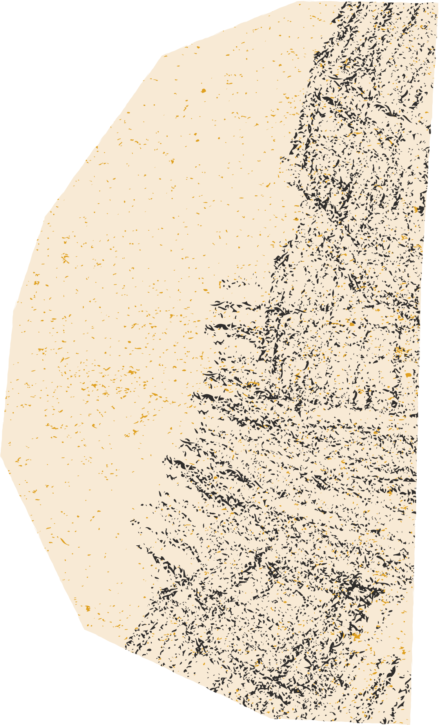



AUTOMATED GRADING SYSTEM
Venumadhavi 21011101086
Kasyap 21011101141
INSPIRED BY

Slide 2




AGS - INTRODUCTION
An automated grading system is a software program that is designed to automatically grade or evaluate student assignments, quizzes, and tests. This type of system uses algorithms to analyze and assess student work, providing feedback and scoring based on predetermined criteria.

Slide 3
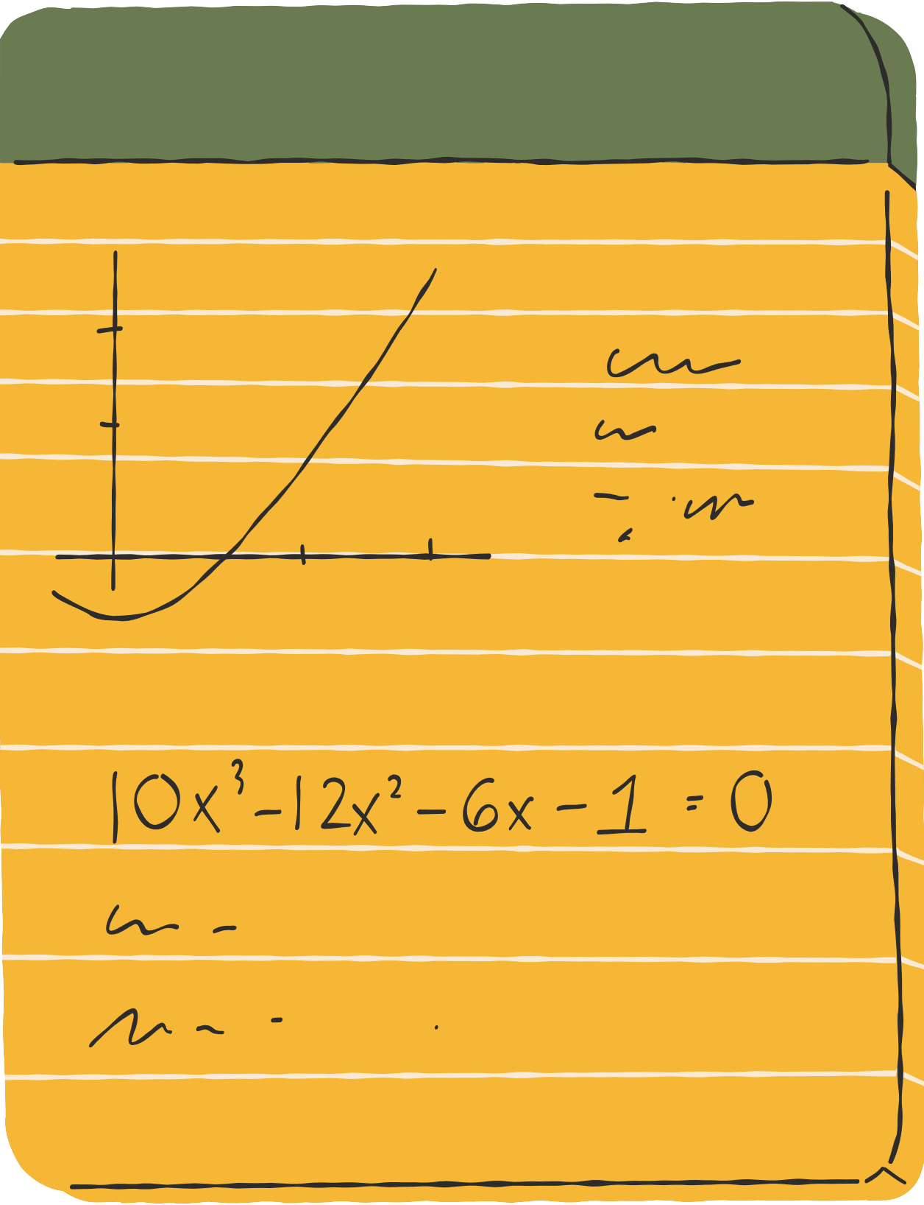

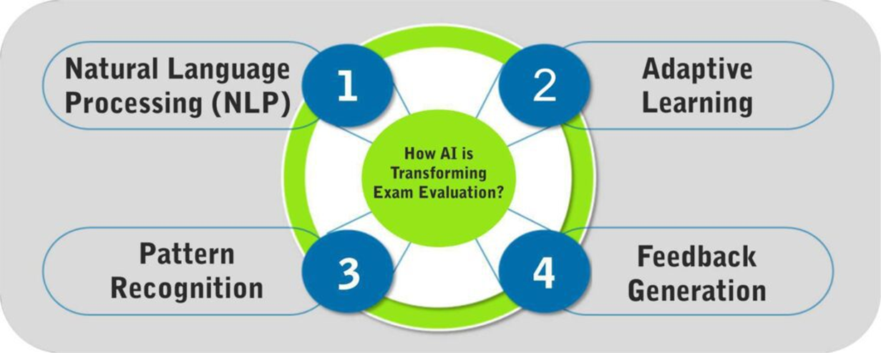


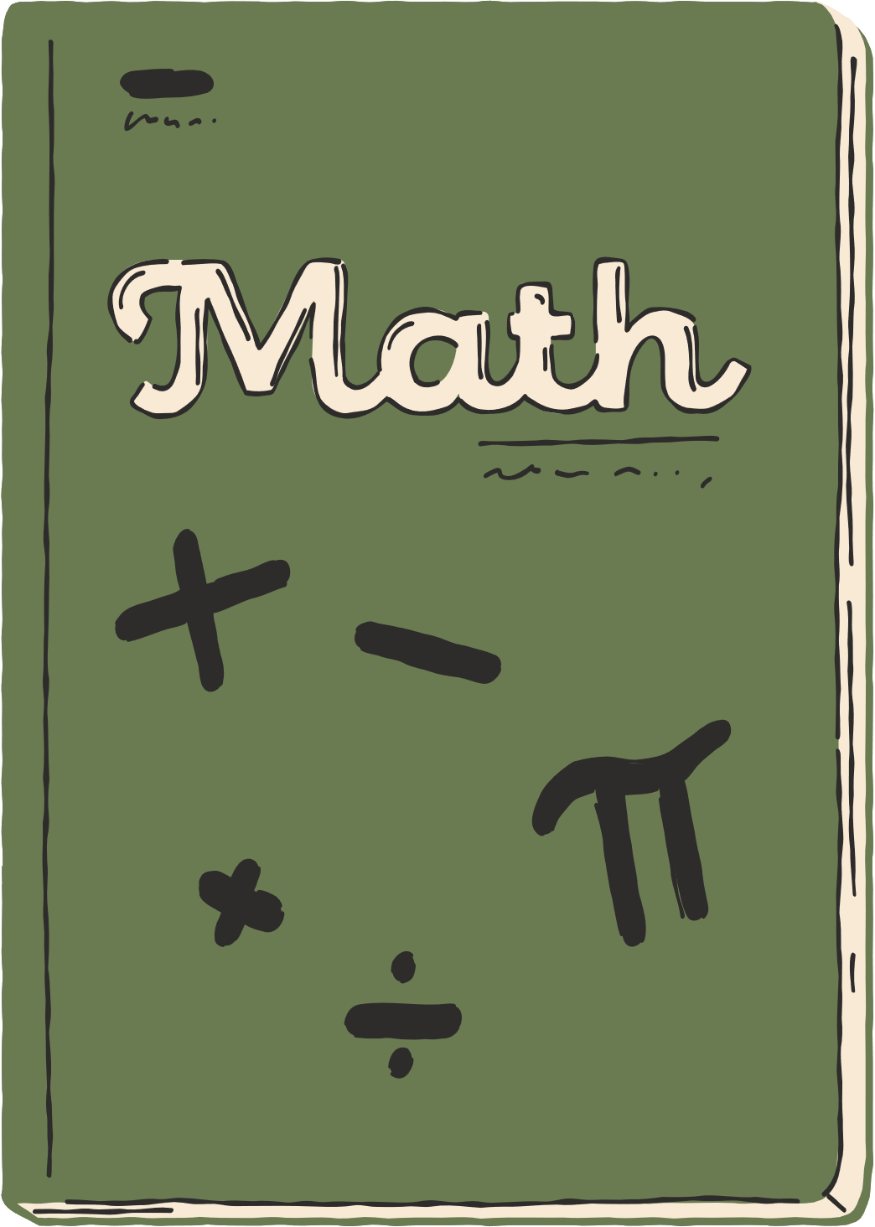

HOW AI IS TRANSFORMING EXAM EVALUATION?

Slide 4



MERITS OF AGS
E
for Efficiency
R
for Resource Optimization
S
for Scalability
A
for Adaptability
O
for Objectivity
I
for Immediate feedback
A
for Adaptability

Slide 5





CHALLENGES
Bias
Complexity

Slide 6




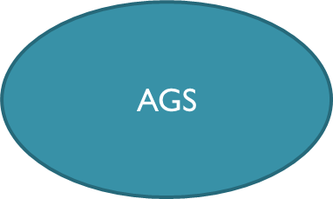

INPUT INPUT/OUTPUT OUTPUT
INPUT/OUTPUT DIAGRAM FOR ADAPTIVE GRADING PROCESS OF THE AGS
Format Detection

Slide 7

IMPLEMENTATION
Imports: Essential libraries loaded.
Data Load: Excel data loaded.
NLP Prep: Tokenization, POS tagging, NER, and response grading functions defined.
Analysis: Evaluation of questions, student responses, and model answers.
Grading: Student responses scored against model answers.
Dataset Creation: Custom dataset classes created.
Model Setup: BERT model instantiated and trained.
Hardware Check: GPU availability verified.
Evaluation: Model evaluated on validation set, accuracy calculated.

Slide 8
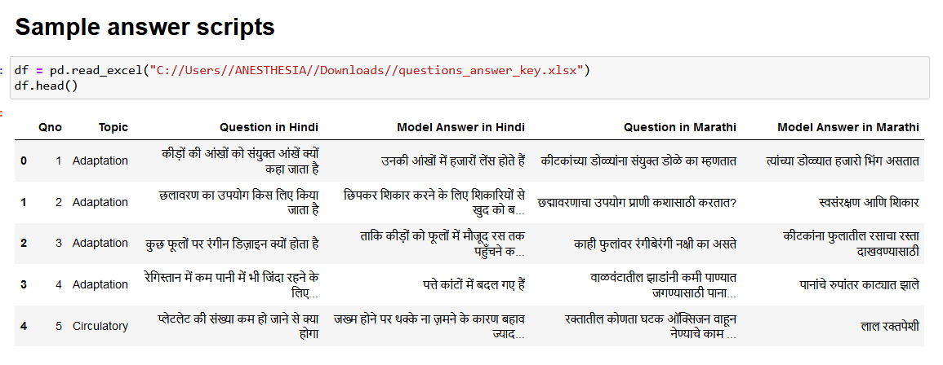
IMPLEMENTATION

Slide 9
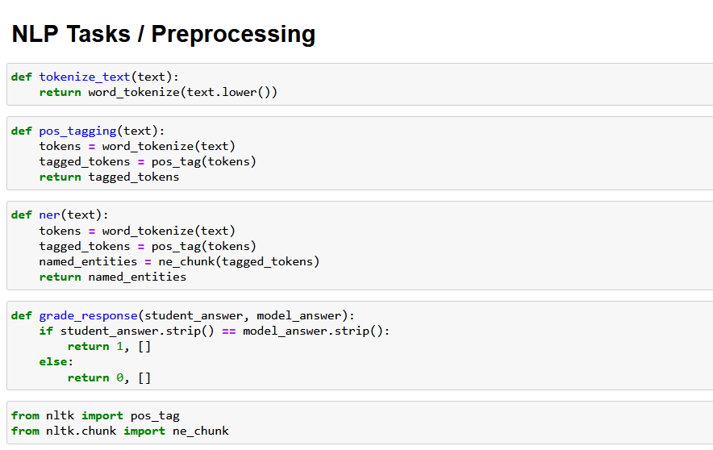
IMPLEMENTATION

Slide 10
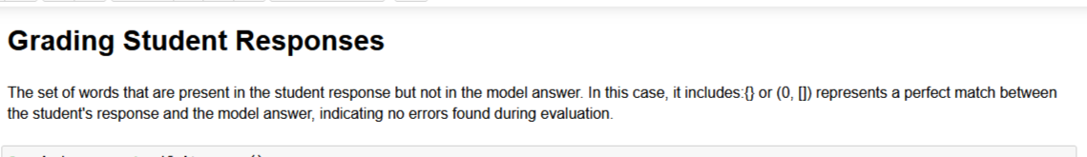
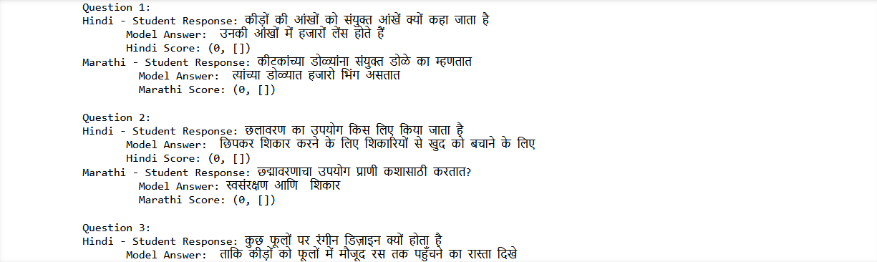
IMPLEMENTATION

Slide 11
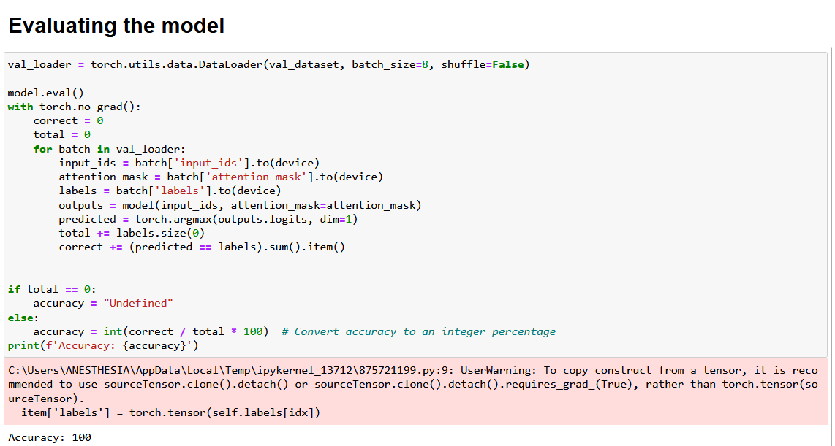
IMPLEMENTATION

Slide 12
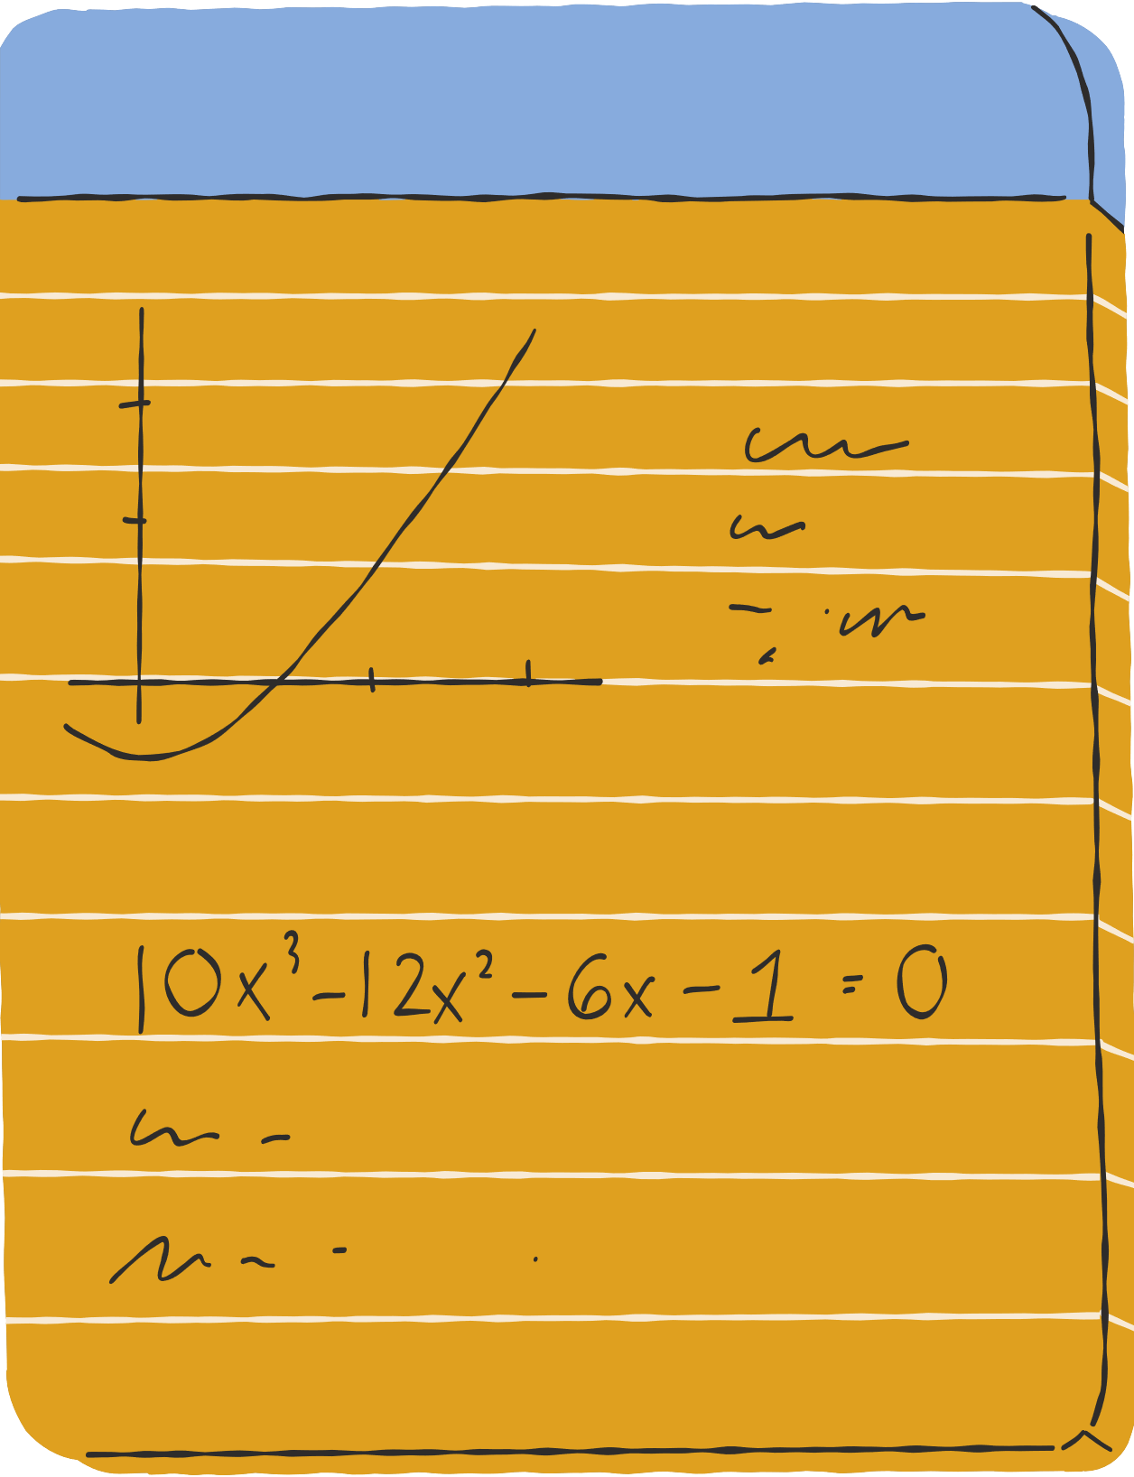



Research papers - references
https://aisel.aisnet.org/cgi/viewcontent.cgi?article=1188&context=jise
https://www.datasciencecentral.com/automated-grading-systems-how-ai-is-revolutionizing-exam-evaluation/

Slide 13


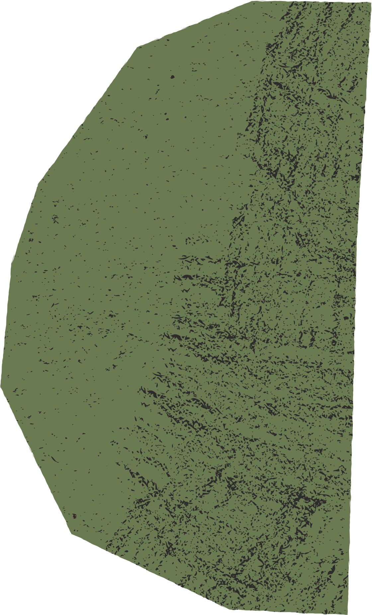



THANK YOU..

